Slide 1
SPARK
Smart Processing & Augmented Retrieval for Knowledge
GenAI × RAG: A Practitioner’s Perspective
Abhishek Pahuja

Slide 2
GenAI with RAG: Turning Documents into Actionable Insights
Overview:
RAG (Retrieval-Augmented Generation) enhances AI by letting it access relevant company data before generating responses, ensuring answers are accurate, context-aware, and actionable.
Why it’s valuable:
Supports faster, informed decision-making
Connects AI directly to organizational knowledge (reports, PDFs, FAQs)
Improves consistency and traceability of insights
How it works (simplified):
A question is asked
Relevant information is retrieved from company data
AI generates a context-rich, reliable answer

Slide 3
Key Concepts with Focus on Chunking
Term | Meaning
GenAI | AI that can read, summarize, or generate text
RAG | A method to ground AI responses in real data
Chunking | Breaking large documents into smaller, meaningful pieces so AI can process them effectively
Retrieve | Finding the most relevant chunks of information
Generate | Producing a clear, actionable answer from retrieved chunks
Context | The background information used to inform the response
Grounded Answer | Response based on actual information, not assumptions
Key point:
Chunking ensures AI can understand large documents without missing critical details or context.

Slide 4
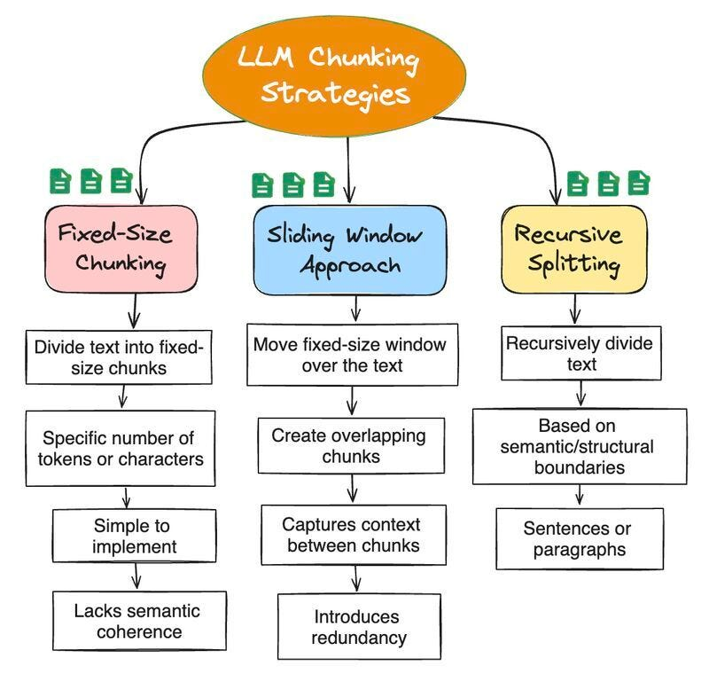
Why Chunking Matters for Business
Scenario: Your company handles hundreds of PDFs, reports, and policies.
AI alone cannot process large files effectively.
Solution:
Chunk documents into smaller, logical segments
RAG retrieves only the relevant chunks for a question
AI generates a concise, accurate answer
Outcome:
Faster insights without missing details
Reduced manual review of long documents
Data-backed decisions delivered efficiently
Business takeaway:
“Chunking transforms large, unstructured data into actionable knowledge — ready for decision-making.”

Slide 5
Business Use Case: Document Insights with Chunking
Use Case: Employees need insights from quarterly reports, audits, or market research PDFs.
Workflow with Chunking:
Large PDFs are split into meaningful chunks
AI retrieves only the relevant chunks for each query
Generates clear, summarized, source-linked answers
Impact:
✅ Access key information 70–80% faster ✅ Better-informed, data-driven decisions ✅ Streamlined knowledge reuse across teams
Tagline:
“Breaking down documents to build better decisions.”

